Slide 1
CSCI 330
THE UNIX SYSTEM
The file system
Notes:
CSCI 330 - The UNIX System
NIU - Department of Computer Science

Slide 2
THE UNIX FILE SYSTEM
hierarchical organization of files
  contains directories and files
basic commands to list and manipulate files
  independent of physical file system organization
  always single tree
typical Unix file system types
  ext3 (formerly ext2)
  reiserfs
  vfat
  ntfs (now read & write)
CSCI 330 - The UNIX System

Slide 3
UNIX FILE SYSTEM LAYOUT
root (/)
bin
home
boot
dev
etc
lib
CSCI 330 - The UNIX System
media
X11
opt
mnt
opt
var
proc
usr
root
sbin
srv
tmp
lib
bin
include

Slide 4
COMMON UNIX DIRECTORIES
bin Essential command binaries
boot Static files of the boot loader
dev Device files
etc Host-specific system configuration
lib Essential shared libraries and kernel modules
media Mount point for removable media
mnt Mount point for temporary file systems
opt Add-on application software packages
proc data on running system
root home directory for system administrator
sbin Essential system binaries
srv Data for services provided by this system
tmp Temporary files
usr Secondary hierarchy
var Variable data
CSCI 330 - The UNIX System

Slide 5
HOME DIRECTORIES ON TURING
/home
ftp
turing
a132436
CSCI 330 - The UNIX System
z2134567
z1544567
z1234467
z1265467

Slide 6
DIRECTORY TERMINOLOGY
Root Directory: /
  top-most directory in any UNIX file structure
Home Directory: ~
  directory owned by a user
  default location when user logs in
Current Directory: .
  default location for working with files
Parent Directory: ..
  directory immediately above the current directory
CSCI 330 - The UNIX System

Slide 7
DIRECTORY CONTENT
regular files
  text, data
  binaries, executables
  links to other files or directories
system files
  device files: character or block special
  networking endpoints:
    sockets
    FIFO
directories
CSCI 330 - The UNIX System

Slide 8
PATHS AND PATHNAMES
path: list of directories separated by “/”
Absolute Pathname
  Traces a path from root to a file or a directory
  Always begins with the root (/) directory
  Example: /home/turing/ray/unix/assign1.txt
Relative Pathname
  Traces a path from the current directory
  No initial forward slash (/)
    dot (.) refers to current directory
    two dots (..) refers to one level up in directory hierarchy
  Example: unix/assign1.txt
CSCI 330 - The UNIX System

Slide 9
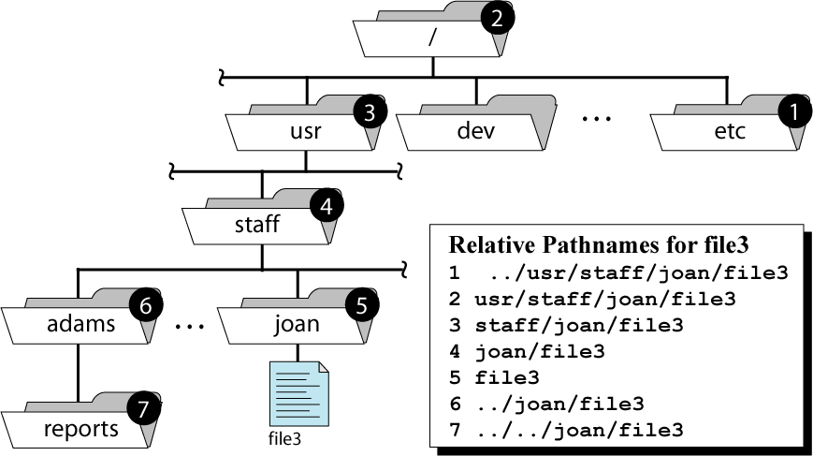
PATHNAMES FOR FILE3
CSCI 330 - The UNIX System
Absolute Pathname: /usr/staff/joan/file3

Slide 10
FILE SYSTEM COMMANDS
Provide information
  pwd
  ls
Change view
  cd
Change
  mkdir
  rmdir
CSCI 330 - The UNIX System

Slide 11
PATH TO CURRENT DIRECTORY
“pwd” gives the full pathname of the current working directory
pwd = print working directory
  Example:
  % pwd
  /home/turing/ray/unix
CSCI 330 - The UNIX System

Slide 12
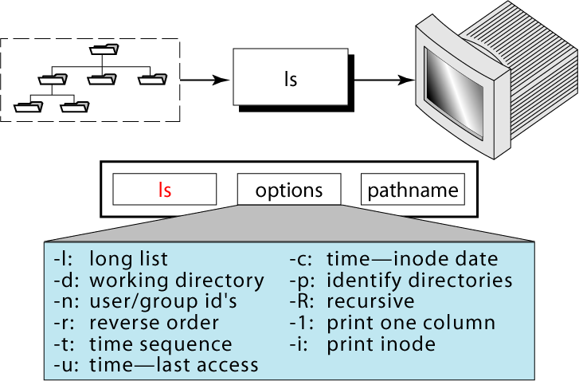
LIST DIRECTORY CONTENT
CSCI 330 - The UNIX System

Slide 13
USEFUL DIRECTORY OPTIONS
ls -Alst | less
  -A include hidden files
    “dot files” start with .
    -A lists all except . and ..
    -a lists all including . and ..
  -l long format
  -s show size of each file in blocks
    1K blocks on some systems
    1/2 K blocks on other systems
  -t in reverse time sequence (most recent first)
  piping into less prevents running off end of screen
CSCI 330 - The UNIX System

Slide 14
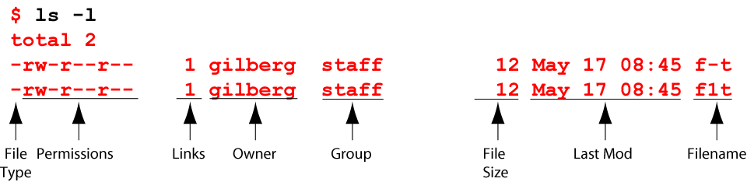
LONG LIST OPTION
CSCI 330 - The UNIX System

Slide 15
LIST EVERYTHING IN DIRECTORY
List contents of the current directory in long format
. is current dir.
.. is parent dir.
% ls -la
total 126
drwxr-xr-x 13 ray csci 1024 Apr 26 15:49 .
drwxr-xr-x 15 root root 512 Apr 24 15:18 ..
-rwx------ 1 ray csci 1120 Apr 12 13:11 .cshrc
-rwxr--r-- 1 ray csci 885 Dec 2 13:07 .login
-rw-r--r-- 1 ray csci 141 Mar 14 13:42 .logout
-rwx------ 1 ray csci 436 Apr 12 11:59 .profile
drwx------ 7 ray csci 512 May 17 14:11 330
drwx------ 3 ray csci 512 Mar 19 13:31 467
drwx------ 2 ray csci 512 Mar 31 10:16 Data
-rw-r--r-- 1 ray csci 80 Feb 27 12:23 quiz.txt
dot (.) names are hidden files
CSCI 330 - The UNIX System
directories
plain file

Slide 16
LIST ALL IN A SPECIFIC DIRECTORY
% ls -l unix/grades
total 10
-rwxr-xr-x 3 ray csci 72 Jan 19 19:12 330assign-graderun
-rwxr-xr-x 1 ray csci 70 Jan 19 19:13 330exam-graderun
-rwxr-xr-x 2 ray csci 70 Jan 19 19:12 330quiz-graderun
-r-x------ 1 ray csci 468 Feb 1 11:55 test-330grade
-r-x------ 1 ray csci 664 Feb 1 11:55 test-330grade,v
CSCI 330 - The UNIX System

Slide 17
PERMISSIONS: TERMINOLOGY
user
  any one who has account on the system
  recognized via a number called “user id”
super user
  “root” user, also known as system administrator
  has user id “0”
  has the maximum set of privileges in the system, i.e. no restrictions apply to what “root” can do
group
  users are organized into groups
  user can belong to multiple groups
CSCI 330 - The UNIX System

Slide 18
PERMISSIONS: CORE CONCEPTS
user info is stored in file /etc/passwd
  userid, user name, group, home directory, shell
  passwords is listed in separate file: /etc/shadow
group info is stored in file /etc/group
  groupid, group name
  additional group members
To find out group information, use the command named: groups user-id
Example:
  % groups z036473
  student csci
CSCI 330 - The UNIX System

Slide 19
SECURITY LEVELS
There are three levels of security in UNIX: system, directory and file
System security
  controlled by the super user
Directory and file
  controlled by the user who owns them
CSCI 330 - The UNIX System

Slide 20
ACCESS PERMISSION TYPES
3 general types of access permissions:
  r read
  w write
  x execute
  - permission denied
CSCI 330 - The UNIX System

Slide 21
ACCESS PERMISSION TYPES
Access Type | Meaning on File | Meaning on Dir.
r (read) | View file contents (open, read) | List directory contents
w (write) | Change file contents | Change directory contents
x (execute) | Run executable file | Make it current directory Access files in it
- | Permission denied | Permission denied
CSCI 330 - The UNIX System

Slide 22
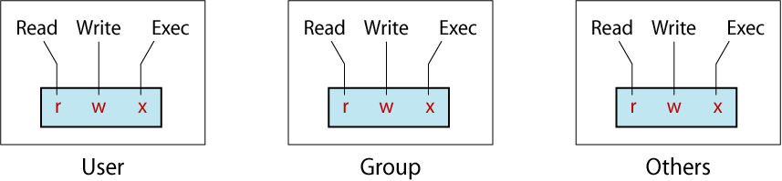
CATEGORIES OF USERS
3 categories of users want access
CSCI 330 - The UNIX System

Slide 23
CHECKING PERMISSIONS
To check the permissions of an existing file or an existing directory, use the command: ls -l
Example:
  % ls -l unix
  total 387
  drwxr--r-- 1 z036473 student 862 Feb 7 19:22 grades
  -rw-r--r-- 1 z036473 student 0 Jun 24 2007 uv.nawk
  -rw-r--r-- 1 z036473 student 0 Jun 24 2007 wx.nawk
  -rw-r--r-- 1 z036473 student 0 Jun 24 2007 yz.nawk
CSCI 330 - The UNIX System

Slide 24
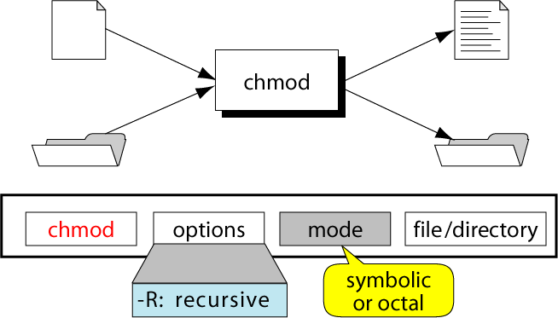
THE CHMOD COMMAND
CSCI 330 - The UNIX System

Slide 25
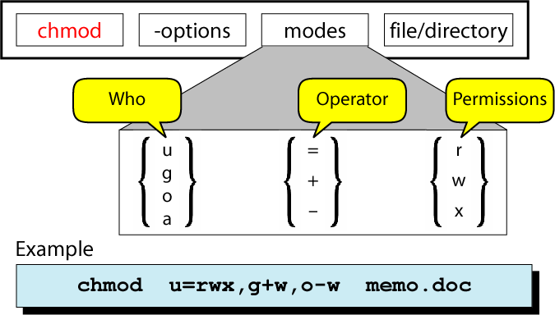
CHANGING PERMISSIONS:
SYMBOLIC MODE
CSCI 330 - The UNIX System

Slide 26
CHANGING PERMISSIONS:
SYMBOLIC MODE
chmod who operation permissions filename
Examples:
% chmod ug=rwx,o=rx sort.c
% chmod ugo+rx,go+w sort.c
u for user
g for group
o for others
a for all
+ for add
- for remove
= for assign
r for read
w for write
x for execute
CSCI 330 - The UNIX System

Slide 27
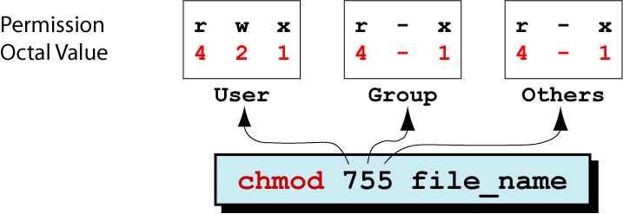
THE CHMOD COMMAND: OCTAL MODE
CSCI 330 - The UNIX System

Slide 28
CHANGING PERMISSIONS: OCTAL MODE
Step | Perform… | Settings
1 | List the desired setting
2 | Assign binary: 1 for access; 0 for no access
3 | List octal values for the corresponding binary 1’s
4 | Convert the octal values to a 3-digit number
5 | Write the command
% ls -l sort.c
-rwxrwxr-x 1 ege csci 80 Feb 27 12:23 sort.c
rwx|rwx|r-x
111|111|101
421|421|401
CSCI 330 - The UNIX System
7 | 7 | 5
chmod 775 sort.c

Slide 29
CHANGING PERMISSIONS: EXAMPLE
Goal: set mode of file “myfile”
  Read, write, and execute permissions to owner
  Read and execute permissions to group
  Execute permission to others
We want: rwx|r-x|--x
CSCI 330 - The UNIX System
1) Using Symbolic Mode: __________________________________
2) Using Octal Mode: __________________________________
chmod u=rwx,g=rx,o=x myfile
chmod 751 myfile

Slide 30
PERMISSION DEFAULT
umask (user mask)
  governs default permission for files and directories
umask –S umask
u=rwx,g=rx,o=rx 0022
in octal form is subtracted from:
  777 for a directory
  666 for a file
can be set to individual value
  Example:
  % umask 011
CSCI 330 - The UNIX System

Slide 31
USER MASK VALUES
User mask Value | Directory Default: 777 | File Default: 666
000 | 777 (rwx rwx rwx) | 666 (rw- rw- rw-)
111 | 666 (rw- rw- rw-) | 666 (rw- rw- rw-)
222 | 555 (r-x r-x r-x) | 444 (r- - r- - r- -)
333 | 444 (r- - r- - r- -) | 444 (r- - r- - r- -)
444 | 333 (-wx –wx –rx) | 222 (-w- -w- -w-)
555 | 222 (-w- -w- -w-) | 222 (-w- -w- -w-)
666 | 111 (- -x - -x - -x) | 000 (--- --- --- )
777 | 000 (--- --- --- ) | 000 (--- --- --- )
CSCI 330 - The UNIX System

Slide 32
SPECIAL PERMISSIONS
The regular file permissions (rwx) are used to assign security to files and directories
Three additional special permissions can be optionally used on files and directories
  Set User Id (SUID)
  Set Group ID (SGID)
  Sticky bit
CSCI 330 - The UNIX System

Slide 33
SPECIAL PERMISSIONS: SUID
SUID used for executable files
  makes executable run with privileges of file owner, rather than the invoker
Example:
  “passwd” command and file “/usr/bin/passwd”
-rwsr-xr-x 1 root root 34888 2007-02-27 13:13 /usr/bin/passwd
allows regular user access to system files while changing password
CSCI 330 - The UNIX System

Slide 34
SPECIAL PERMISSIONS: SGID
  logic is similar to SUID bit
used for executable files
runs program with group permission of file, rather than group of invoker
Example:
if a file is owned by the system group and also has the SGID bit set, then any user who executes that file will be a member of the system group during the execution
CSCI 330 - The UNIX System

Slide 35
SPECIAL PERMISSIONS: STICKY BIT
not clearly defined
for executable files:
  executable is kept in memory even after it ended
for directories:
  file can only be deleted by the user that created it
CSCI 330 - The UNIX System

Slide 36
SPECIAL PERMISSIONS: DISPLAY
“ls -l” command does not have a section for special permission bits
however, since special permissions required “execute”, they mask the execute permission when displayed using the “ls -l” command.
CSCI 330 - The UNIX System
r w x r w x r w x
r w s r w s r w t
SUID
SGID
STICKY
BIT

Slide 37
SPECIAL PERMISSIONS: DISPLAY
If special permission bits are set on a file or a directory without “execute” permission, the special permissions are shown in capital letters
r w - r w - r w -
CSCI 330 - The UNIX System
r w S r w S r w T
SUID
SGID
STICKY
BIT

Slide 38
SETTING SPECIAL PERMISSIONS
suid | sgid | stb | r | w | x | r | w | x | r | w | x
4 | 2 | 1 | 4 | 2 | 1 | 4 | 2 | 1 | 4 | 2 | 1
7 |  |  | 7 |  |  | 7 |  |  | 7
Special |  |  | user |  |  | group |  |  | others
CSCI 330 - The UNIX System
Use the “chmod” command with octal mode:
chmod 7777 filename

Slide 39
SETTING SPECIAL PERMISSIONS
chmod with symbolic notation:
+s add SUID and SGID
g+s add SGID
g-s remove SGID
u+s add SUID
u-s remove SUID
+t set sticky bit
CSCI 330 - The UNIX System

Slide 40
SUMMARY
r, w, x
  and extra bits
user, group, world
user mask
CSCI 330 - The UNIX System

Slide 41
FILE NAME EXPANSION
Wildcard characters allow to select files that satisfy a particular name pattern
Character | Description | Example
* | Match zero or more char. | ls *.c
? | Match any single character | ls conf.?
[list] | Match any single character in list | ls conf.[co]
[lower-upper] | Match any character in range | ls lib-id[3-7].o
str{str1,str2,…} | Expand str with contents of { } | ls c*.{700,300}
CSCI 330 - The UNIX System

Slide 42
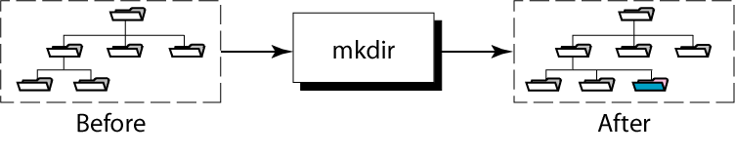
CREATING A NEW DIRECTORY
Syntax:
mkdir [ -p ] directory-list
CSCI 330 - The UNIX System

Slide 43
MKDIR EXAMPLES
Can create one or more directories at a time
-p = creates intermediate directories if necessary
  Examples:
  % mkdir csci330
  % mkdir dirOne dirTwo
  % mkdir /home/turing/ray/unix/demo
  (intermediate directories must already exist)
  % mkdir –p /home/turing/ray/unix/demo
  (creates intermediate directories if needed)
CSCI 330 - The UNIX System

Slide 44
FILE AND DIRECTORY NAMES
Use the following characters:
  Uppercase letters (A-Z)
  Lowercase letters (a-z)
  Numbers (0-9)
  Underscore ( _ )
  Period/dot ( . )
CSCI 330 - The UNIX System

Slide 45
FILE AND DIRECTORY NAMES
avoid the following characters:
& | * | \ | | | [ ] | {}
$ | <> | () | # | ? | /
“ | ‘ | ; | ^ | ! | ~
Space | Tab
CSCI 330 - The UNIX System

Slide 46
EXAMPLE: CREATE A DIRECTORY
to create directory called Data under csci330
Absolute Pathname:
Relative Pathname:
dev
etc
home
usr
tty
null
skel
turing
ux
bin
local
ucb
You are here
z036473
csci330
unix
demo
Temp
CSCI 330 - The UNIX System
Data
mkdir /home/turing/z036473/csci330/Data
mkdir csci330/Data

Slide 47
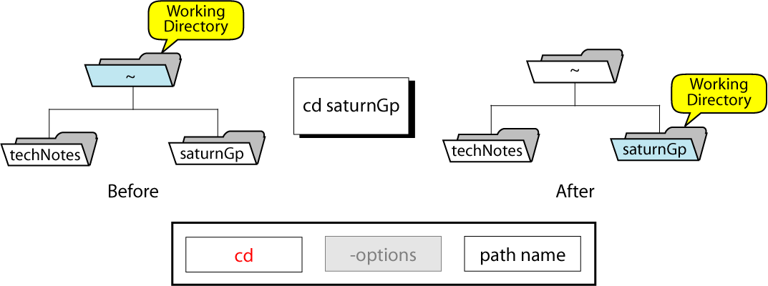
CHANGING DIRECTORY
(just changes the view!)
CSCI 330 - The UNIX System

Slide 48
CHANGING DIRECTORY
from the Data directory, go to home directory
Absolute Pathname:
Relative Pathname:
dev
etc
home
usr
tty
null
skel
turing
ux
bin
local
ucb
z036473
csci330
unix
demo
Temp
You are here
Data
CSCI 330 - The UNIX System
cd /home/turing/z036473
cd ~
cd
cd ../..

Slide 49
REMOVE DIRECTORIES
If empty, use “rmdir”
  Example: To remove an empty directory called “test”
  % rmdir test
if non-empty, use “rm -r”
  Example: To remove non-empty directory “old-data”
  % rm -r old-data
  Safer to just delete the contents first
CSCI 330 - The UNIX System

Slide 50
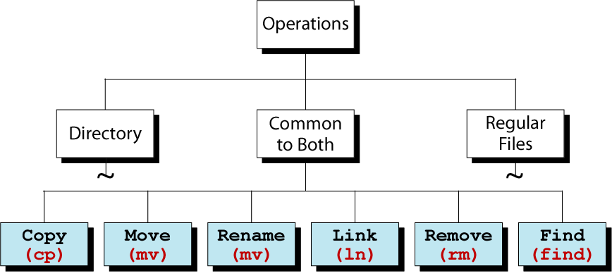
FILE SYSTEM COMMANDS
CSCI 330 - The UNIX System

Slide 51
COPYING FILES
To copy a file, use “cp”
Syntax: cp source-file target
Commonly used options:
  -i if “target” exists, the command cp prompts for confirmation before overwriting
  -i is not the default, but should be
  you can make -i the default
  -p preserve permissions and modification times
  -p is not the default, but should be
  you can make -p the default
  -r recursively copy files and subdirectories
CSCI 330 - The UNIX System

Slide 52
COPYING A FILE
Make a copy of a file
% cp assign1.txt assign1.save
Copy “assign1.txt” to a different directory
% cp assign1.txt ~/archive
% cp assign1.txt ~/archive
but suppose archive isn’t a directory
suppose it doesn’t exist
Copy “assign1.txt” to a new name in a different directory
% cp assign1.txt ~/archive/assign1.save
CSCI 330 - The UNIX System

Slide 53
COPYING MULTIPLE FILES
Syntax: cp source-files destination-directory
  % cp assign1.txt assign2.txt ~/archive
  % cp assign?.txt ~/archive
Files will have same name in destination directory
CSCI 330 - The UNIX System

Slide 54
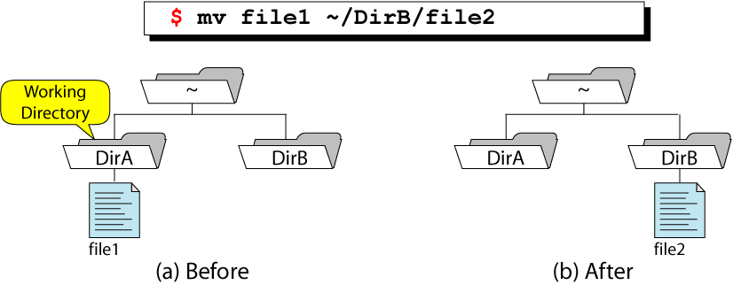
MOVING FILES
To move files from one directory to another directory, or to re-name a file, use: “mv”
CSCI 330 - The UNIX System

Slide 55
MOVING A FILE
Move “assign1.txt” a different directory
  If the destination file exists, “mv” will not overwrite exiting file:
  % mv assign1.txt ~/archive
Move “assign1.txt” a different directory and rename it to “assign1.save”
% mv assign1.txt ~/archive/assign1.save
CSCI 330 - The UNIX System

Slide 56
MOVING MULTIPLE FILES
Syntax: mv source-files destination-directory
  % mv assign1.txt assign2.txt ~/archive
  % mv assign?.txt ~/archive
Files will have same name in destination directory
CSCI 330 - The UNIX System

Slide 57
RENAMING FILES OR DIRECTORIES
use “mv”
Example: rename file “unix” to “csci330”
  % mv unix csci330
Caveat: what if “csci330” exists and is a directory ?
CSCI 330 - The UNIX System

Slide 58
DELETING FILES
Syntax: rm file-list
Commonly used options:
  -f force remove regardless of permissions
  -i prompt for confirmation before removing
  -r removes everything under the indicated directory
Example: remove file “old-assign”
  % rm unix/assign/old-assign
CSCI 330 - The UNIX System

Slide 59
LINKING FILES
Allows one file to be known by different names
A link is:
  A reference to a file stored elsewhere on the system
  A way to establish a connection to a file to be shared
Two types:
  Hard link
  Symbolic link (a.k.a. “soft link”)
CSCI 330 - The UNIX System

Slide 60
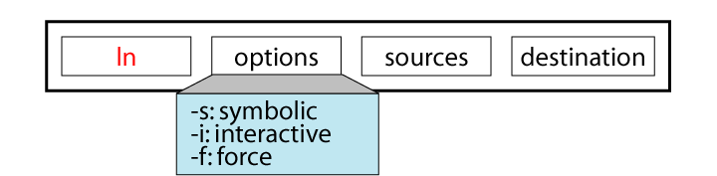
THE LN COMMAND
hard link:
ln shared-file link-name
symbolic link:
ln –s shared-file link-name
Note that the long listing (ls -l) of a soft link does not accurately reflect its associated permissions. To view the permissions of the file or directory that the symbolic link references, use the -L option of the ls command.
CSCI 330 - The UNIX System

Slide 61
LINK ILLUSTRATION
create entry “bb” in “dir3” as link to file “aa” in “dir1”
home
z036473
dir1
dir2
CSCI 330 - The UNIX System
aa
dir3
bb

Slide 62
HARD LINK EXAMPLE
Contents of dir1
.
. | 1076
.. | 2083
aa | 2407
home
2406
2407
z036473
2408
.
dir1
dir2
CSCI 330 - The UNIX System
.
Contents of dir3
aa
dir3
. | 1070
.. | 2050
bb | 2407
file data
bb

Slide 63
SYMBOLIC LINK EXAMPLE
Contents of dir1
.
. | 1076
.. | 2083
aa | 2407
home
2598
2599
z036473
2600
.
dir1
dir2
CSCI 330 - The UNIX System
.
Contents of dir3
aa
dir3
. | 1070
.. | 2050
bb | 2599
home/z036473/
dir1/aa
bb

Slide 64
HARD LINK VS. SYMBOLIC LINK
Hard Link Advantages | Symbolic Link Advantages
Checks for the existence of the original file The original file continues to exist as long as at least one directory contains it | Can use either relative or absolute path to access the original file Can cross physical file systems
CSCI 330 - The UNIX System

Slide 65
HARD LINK VS. SYMBOLIC LINK
Hard Link Disadvantages | Symbolic Link Disadvantages
Cannot link to a file in a different file system Prevents deleting file if another link is exists | Created without checking the existence of the shared file Cannot access the shared file if its path has restricted permissions Can be circular linked to another symbolic linked file
CSCI 330 - The UNIX System

Slide 66
FINDING FILES
The command named “find” can be used to locate a file or a directory
Syntax: find pathname-list -name expression
“find” recursively descends through pathname-list and applies expression to every file
CSCI 330 - The UNIX System

Slide 67
FINDING FILES
Example 1: Find all files, in your directory hierarchy, that have name ending with “.bak”
  % find ~ -name “*.bak” -print
Example 2: Find all files, in your directory hierarchy, that were modified yesterday
  % find ~ -mtime -1 -print
CSCI 330 - The UNIX System

